Slide 1

Suppression Tracker
Press Release | 29th June 2020

Slide 2
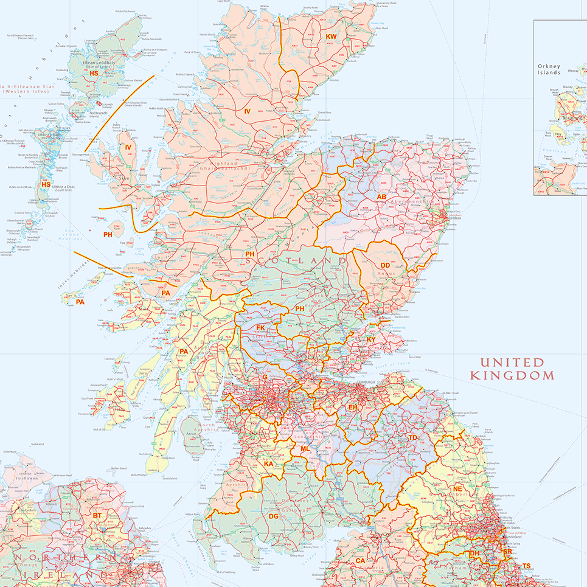
Suppression Tracker launches
Tidyverse troopers, a proud volunteer team in the Scottish Tech Army, are delighted to announce today the immediate availability of Suppression Tracker, playing our part in the bid to eliminate Covid-19 in Scotland.
There are many online places where we can find facts, figures, charts, and opinions on Covid-19 cases in Scotland. However, there is no single destination that displays all relevant information regarding our local communities, the data is distributed, often fragmented, and is not accessible to everyone without specialist skills.
Suppression tracker™ is an interactive map providing a single place to track and monitor all key metrics regarding Coronavirus cases in their local area. It has been inspired by the success of other countries in suppressing the virus and the ongoing work of Professor @DeviSridhar in highlighting the key metrics we all need to be aware of to ensure continued success.
The map allows individuals to drill down to see relevant metrics at an individual Health Board level and supports display at a postcode level if the data can be provided by the relevant authorities. Our vision is to have all statistics available at postcode level granularity and would urge anyone involved in the collation of these statistics to get in touch and help us incorporate these. Reach out to team@suppressiontracker.scot
http://www.suppressiontracker.scot

Slide 3
A first draft based on the idea of “Working Backwards” from Amazon. If we can’t easily explain the benefits to our intended consumers then we should iterate the messaging until it does. The theory being it will be quicker to do this with text than once we have started building a solution.
Some additional thoughts on what it might look like, the data available, and existing charts / datavis so that we can try to avoid reinventing the wheel.

Slide 4
Potential functionality | Straw Man
Data could include
RAG status
SIMD percentile (postcode level)
Devi Sridhar’s key metrics (next slide)
Hover = high level stats
Click to drill down to Health Board / Post code level data
Drill down display could include
historical trend data
Prediction / trend line
Population density
SIMD percentile
Council data
Schools data
MSPs
Shop data? What’s opened?
Footfall?
Stuff you can do locally? Cycle routes?
Could be pulled from https://docs.aliss.org
Clutching at straws…

Slide 5
Potential measures
Measure | Granularity | Dataset | Notes
Number of confirmed new cases by day | Health Board
Number of people tested by day | Country
Time for test results to be returned | Unavailable
Number of people traced | Unavailable
Percentage in isolation and monitored | Unavailable
Number of daily hospital admissions | Health Board
Number of NHS 111 calls | Country |  | Includes all calls, not just Covid-19
Number of people living in area | Postcode | See next slide
https://twitter.com/devisridhar/status/1272075850972835840?s=20

Slide 6
Additional data sources
Data set | Publisher | Link | Notes
Postcode directory data | National Records of Scotland | https://www.nrscotland.gov.uk/statistics-and-data/geography/our-products/scottish-postcode-directory/2020-1
Population data | Scotland’s census | https://www.scotlandscensus.gov.uk/ods-web/data-warehouse.html | From 2011 Census
Links and refs to various open data sets |  | https://codethecity.co.uk/2019/02/24/scotlands-open-data-february-2019-an-update/
 |  | https://covid.joinzoe.com

Slide 7
Examples of existing dashboards & map data
https://covid.joinzoe.com/data < Results from analysis Zoe, includes map data. Raw data is not being share openly
https://www.thecourier.co.uk/fp/news/politics/scottish-politics/1200709/coronavirus-in-scotland-track-the-spread-in-these-charts-and-maps/ < 1 of 2 detailed series of charts on Scottish data. Uses https://flourish.studio
https://www.thecourier.co.uk/fp/news/politics/scottish-politics/1268833/coronavirus-in-scotland-how-does-geography-gender-location-and-age-affect-covid-19-deaths/ < 2 of 2. Inc occupation analysis. Uses https://flourish.studio
https://www.opendata.nhs.scot/dataset/weekly-covid-19-statistical-data-in-scotland < CSV files
https://statistics.gov.scot/resource?uri=http%3A%2F%2Fstatistics.gov.scot%2Fdata%2Fcoronavirus-covid-19-management-information < Data Cube dataset
https://www.arcgis.com/apps/opsdashboard/index.html#/658feae0ab1d432f9fdb53aa082e4130 < Dashboard and map showing data by Health Board
https://scotland.shinyapps.io/phs-covid-wider-impact/ < Public health data showing the comparison between 2020 and previous years

